Slide 1
RxJS
Caching Observables
Lecture 9
By James(Jin) Wang
12/05/2021

Slide 2
Outline
Caching Observables
Patterns for data caching

Slide 3
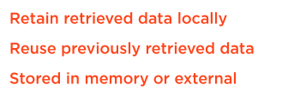
Caching Observables
  Caching Observables

Slide 4
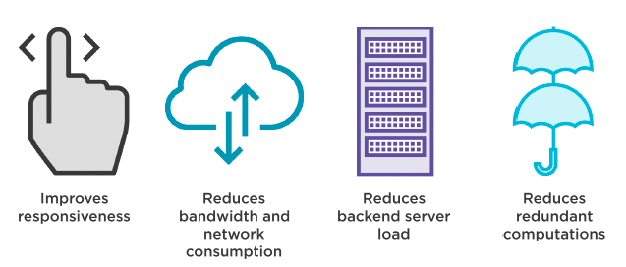
Caching Observables
  Advantage of Caching Data

Slide 5
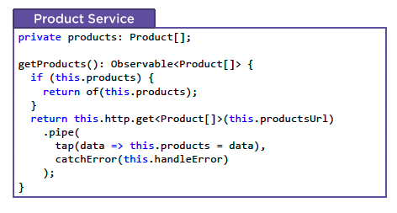
Patterns for data caching
  Classic Caching Pattern

Slide 6
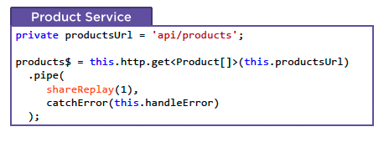
Patterns for data caching
  Declarative Caching Pattern

Slide 7
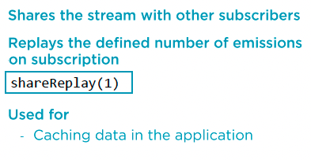
Patterns for data caching
  RxJS Operator: shareReplay

Slide 8
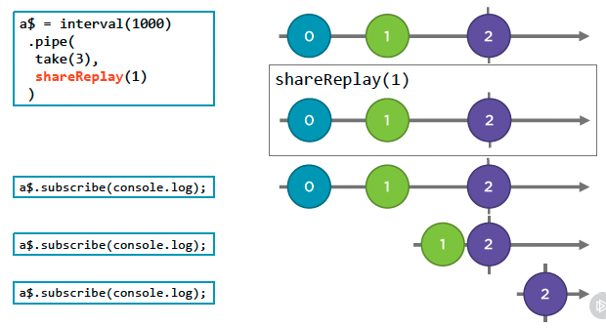
Patterns for data caching
  Marble Diagram: shareReplay

Slide 9
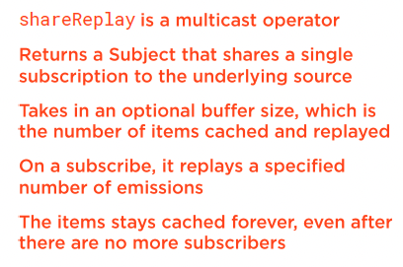
Patterns for data caching
  RxJS Operator: shareReplay
  Demo: cache data with shareReplay

Slide 10
Summary

Slide 11
Assignment

Slide 12
Self Study
  RxJS: The Big Picture
  https://app.pluralsight.com/library/courses/rxjs-big-picture

